Slide 1
Native American Petroglyphs
SUSHIL AHUJA

Slide 2
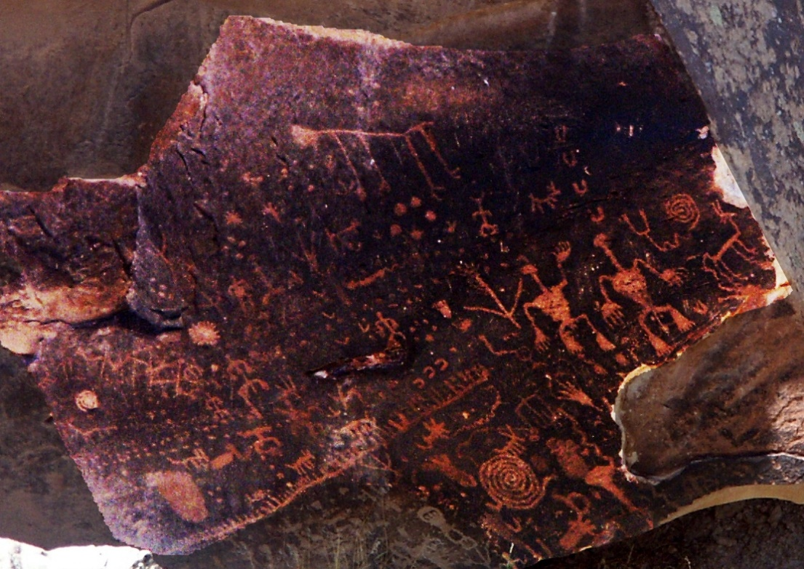
What Is a Petroglyph?
Image carved into rock
Word comes from
Glyph is a carved image
Prefix petro comes from the Greek for rock
Usually made by scratching dark layer off
Exposes lighter underneath layer

Slide 3
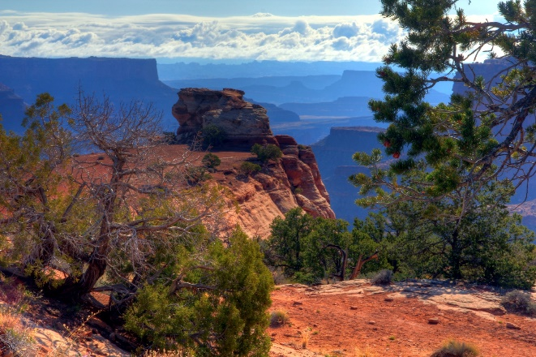
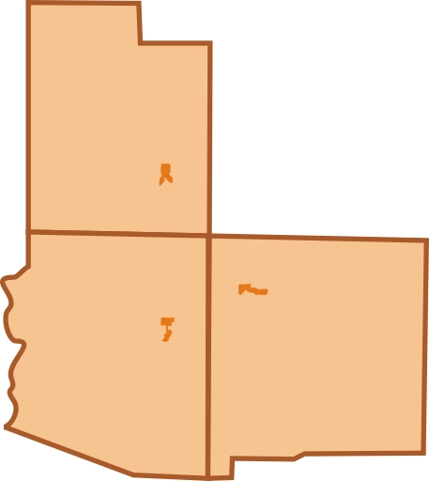
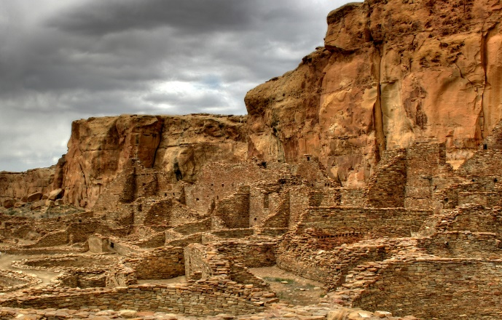
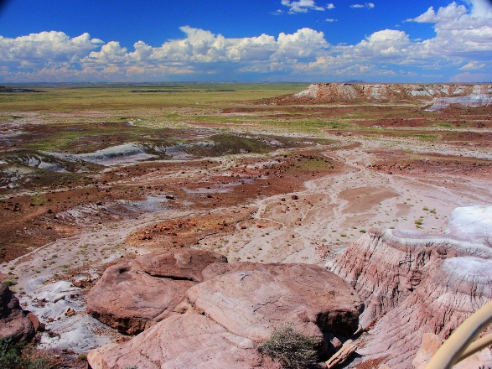
Petroglyph Locations in the Southwest
UTAH
ARIZONA
NEW MEXICO
Petrified Forest National Park, NM
Canyonlands National Park, UT
Chaco Culture National Historical Park, AZ

Slide 4
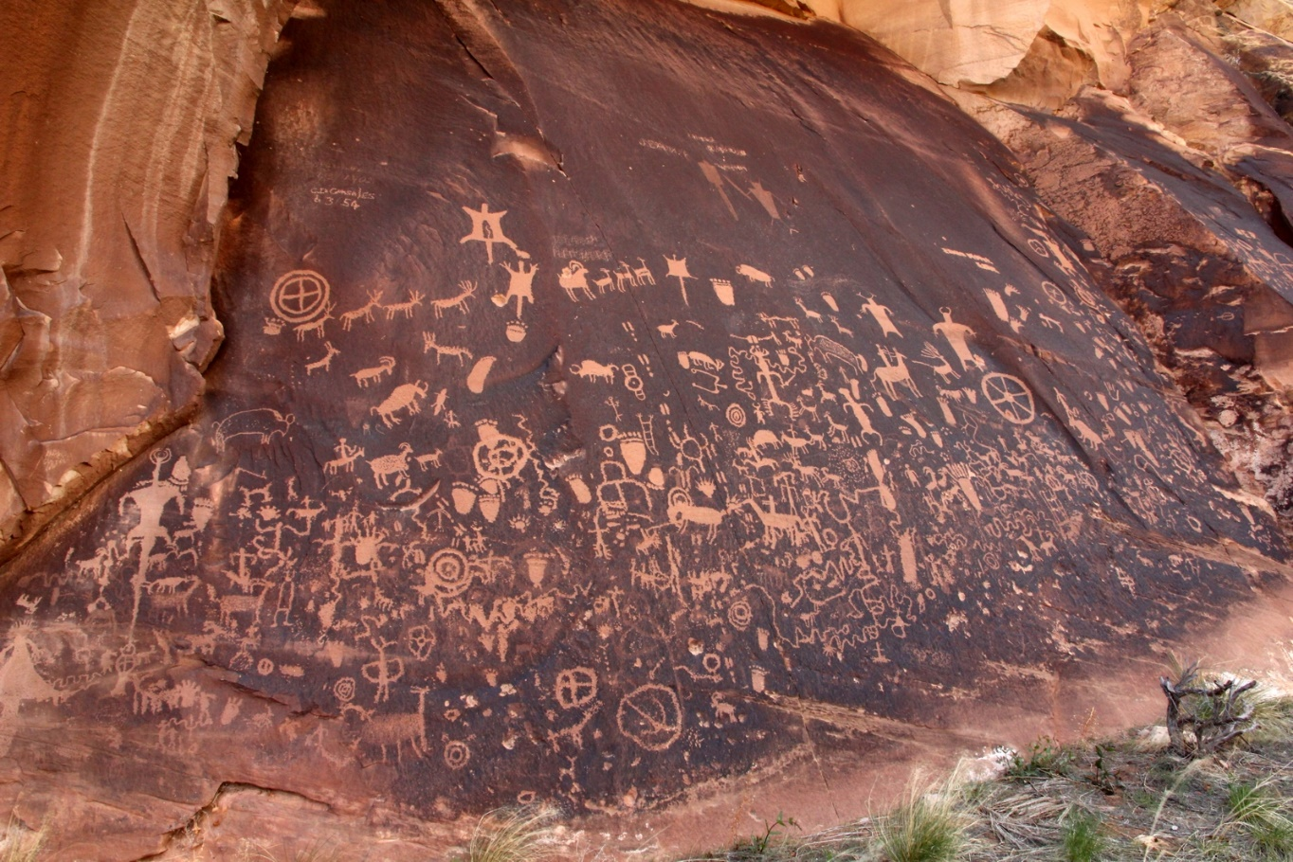
Newspaper Rock, Utah
Rocks covered in petroglyphs
Contains over 650 designs
First carvings made 2,000 years ago
Tse’ Hane
Navajo
“Rock that tells a story”

Slide 5
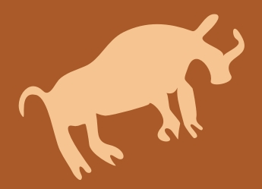
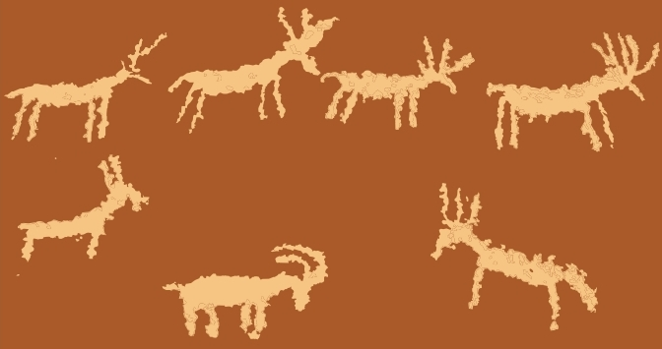


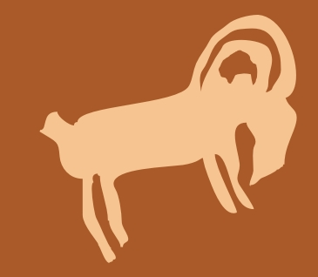

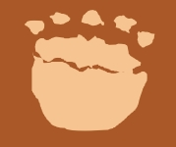
Examples of Images
Bison
Deer Herd
Squirrel
Gila Monster
Big Horn Sheep
Symbol
Bear Pawprint

